Slide 1
AZ-303
Microsoft Azure Architect Technologies Practice Exam

Slide 2
DOMAIN BREAKDOWN
Implement and Monitor an Azure Infrastructure 50%
Implement Management and Security Solutions 30%
Implement Solutions for Apps 10%
Implement and Manage Data Platforms 10%

Slide 3
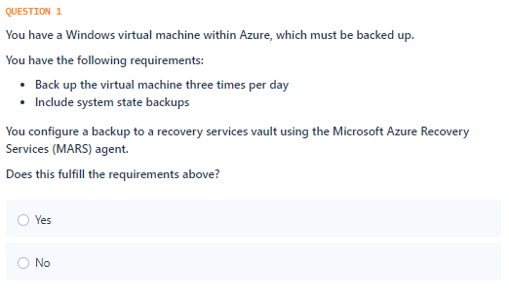

Slide 4
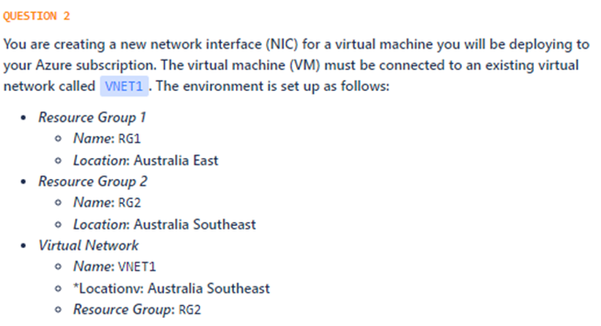
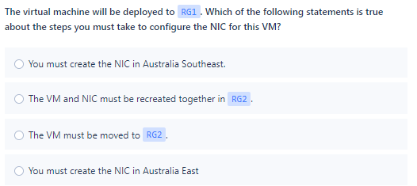

Slide 5
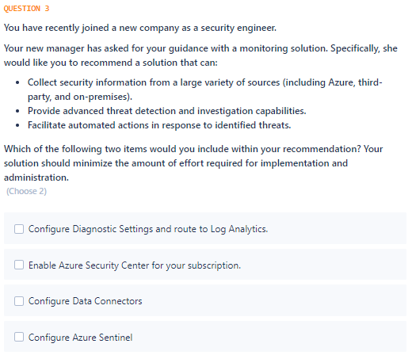

Slide 6
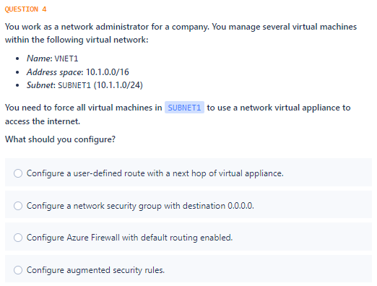

Slide 7
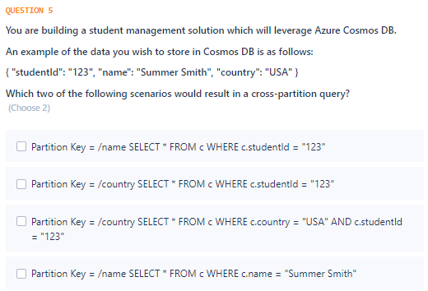

Slide 8
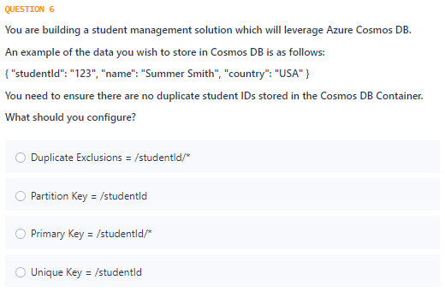

Slide 9
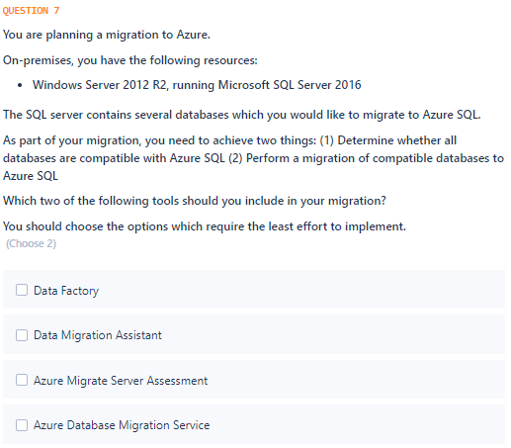

Slide 10
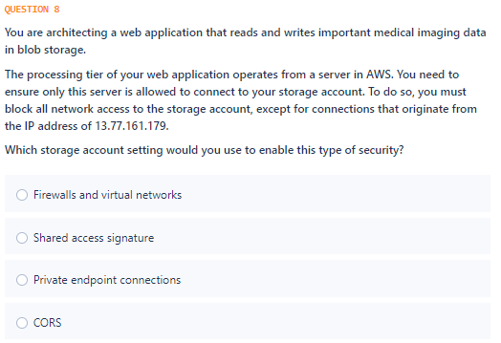

Slide 11
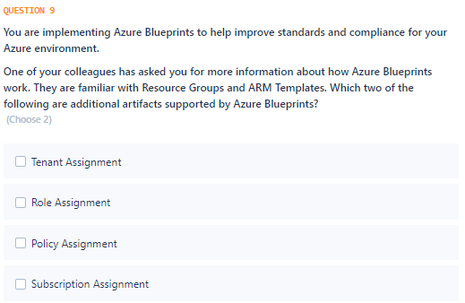

Slide 12
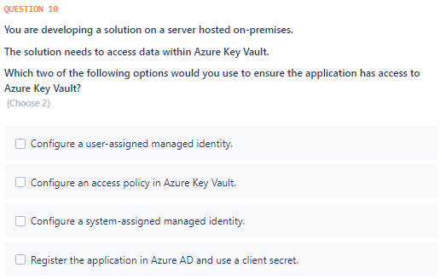

Slide 13
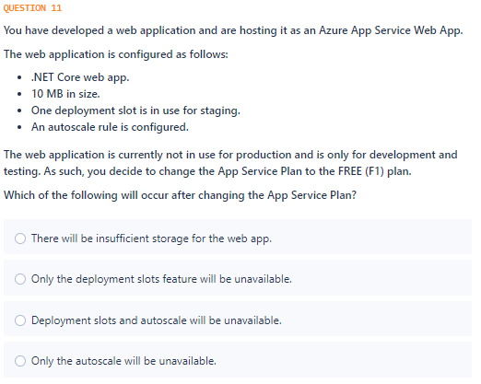

Slide 14
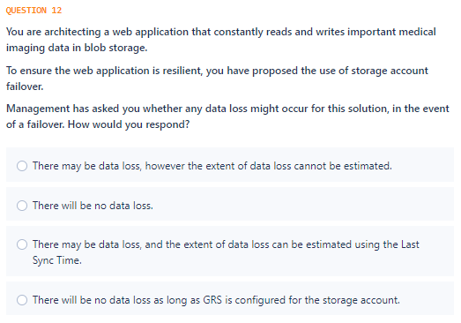

Slide 15
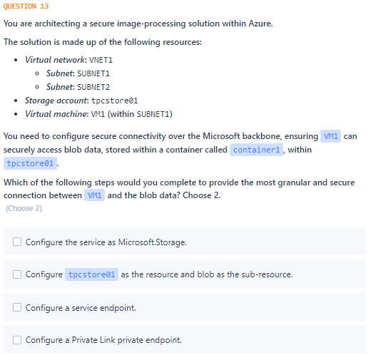

Slide 16
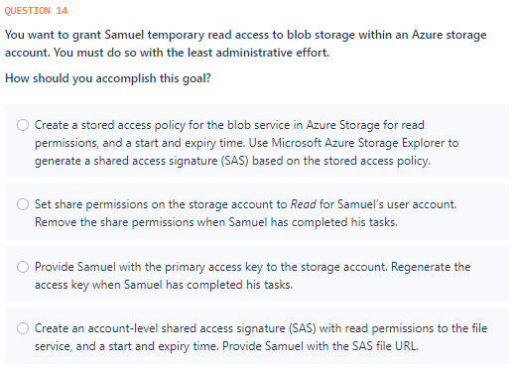

Slide 17
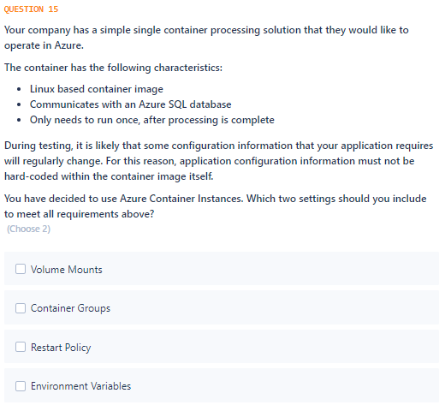

Slide 18
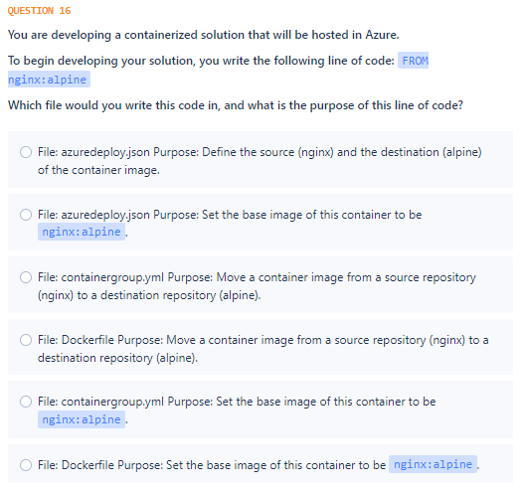

Slide 19
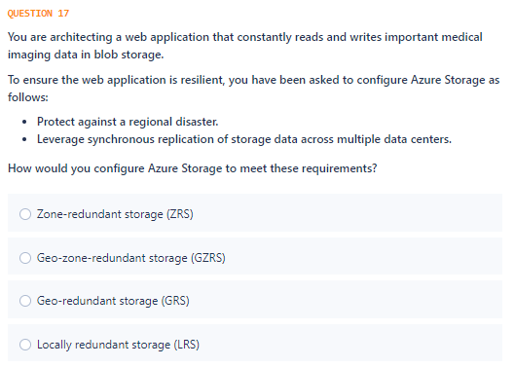

Slide 20
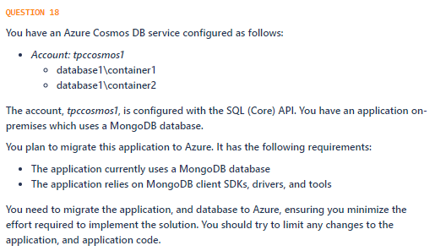
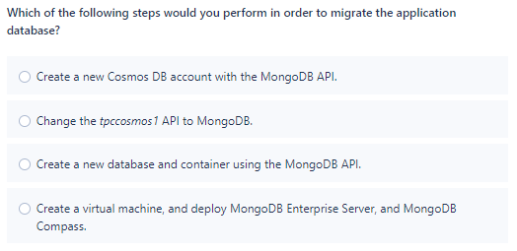

Slide 21
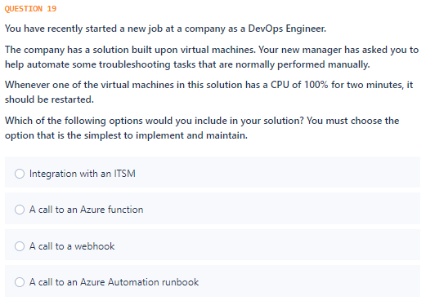

Slide 22
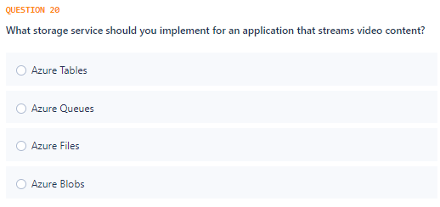

Slide 23
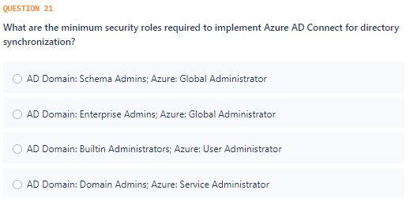

Slide 24
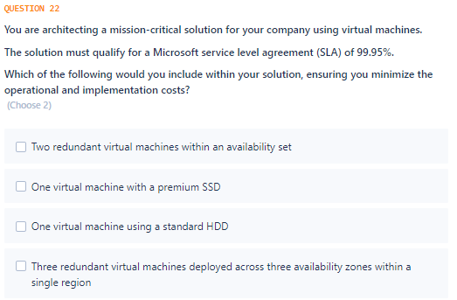

Slide 25
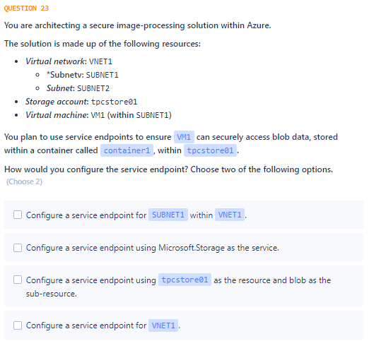

Slide 26
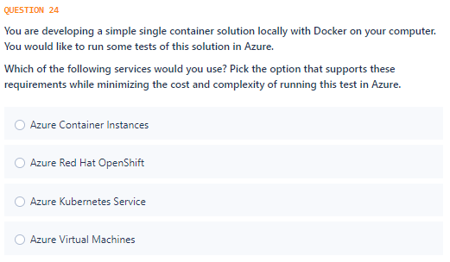

Slide 27
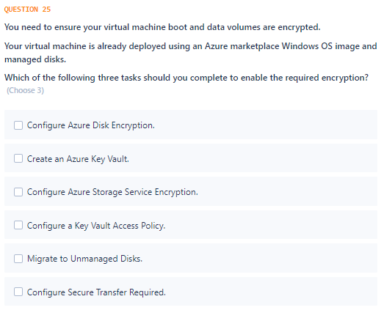

Slide 28
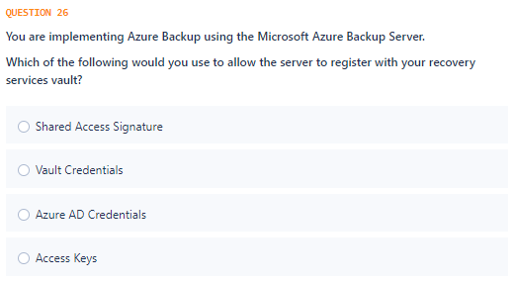

Slide 29
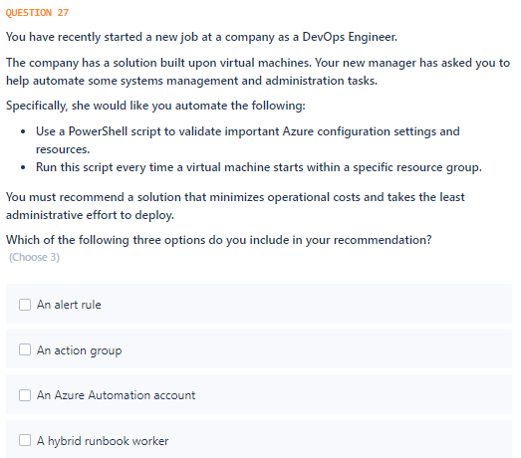

Slide 30
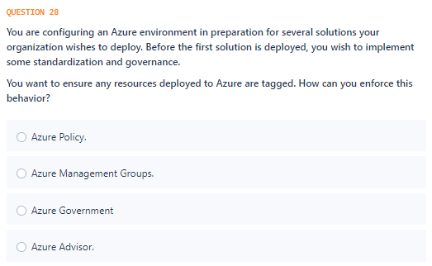

Slide 31
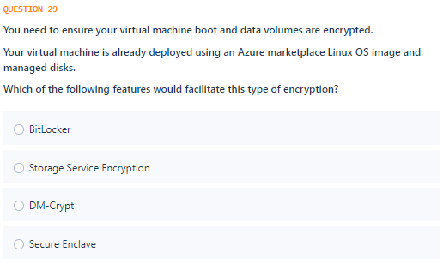

Slide 32
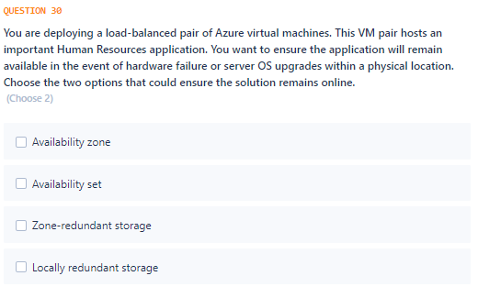

Slide 33
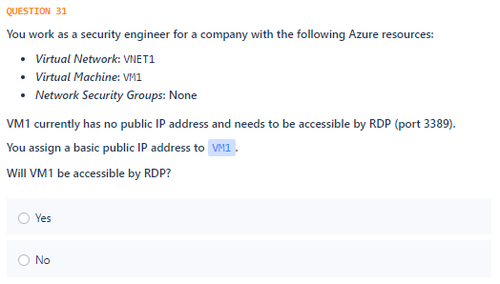

Slide 34
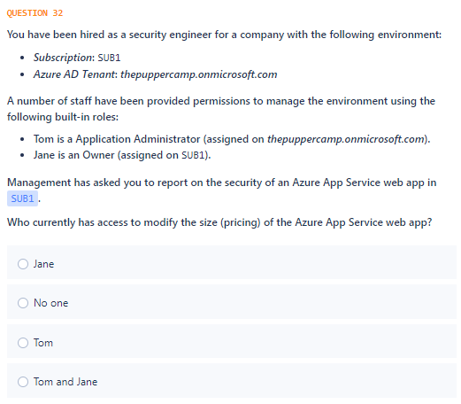

Slide 35
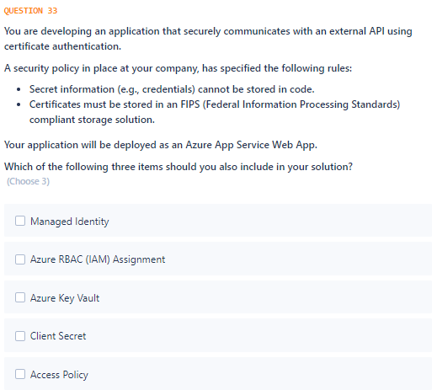

Slide 36
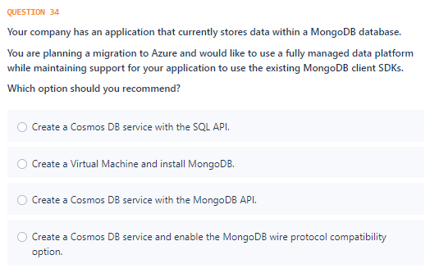

Slide 37
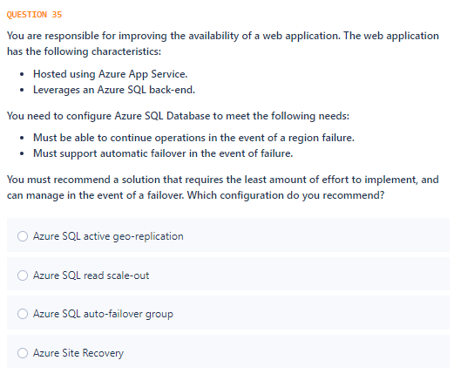

Slide 38
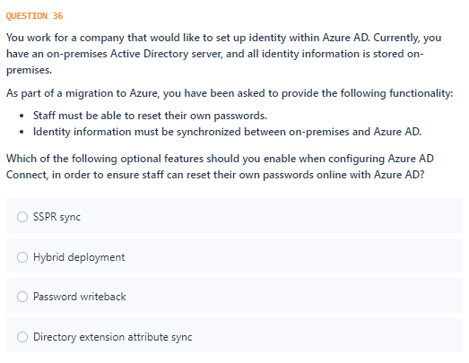

Slide 39
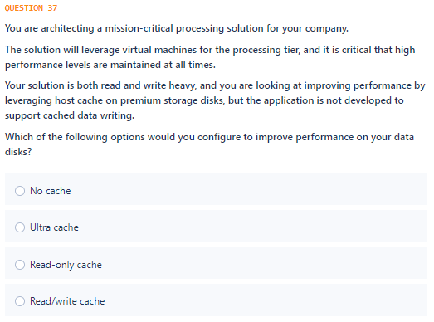

Slide 40
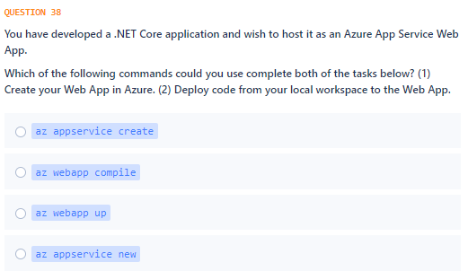

Slide 41
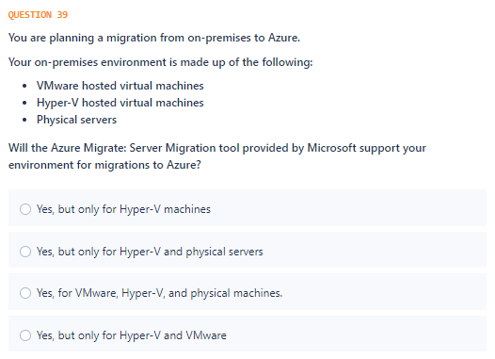

Slide 42
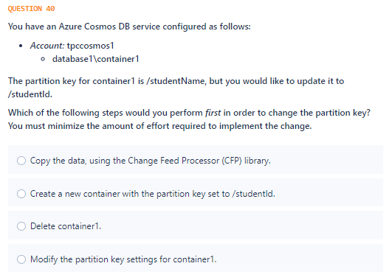

Slide 43
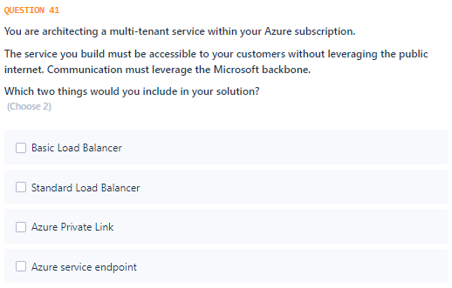

Slide 44
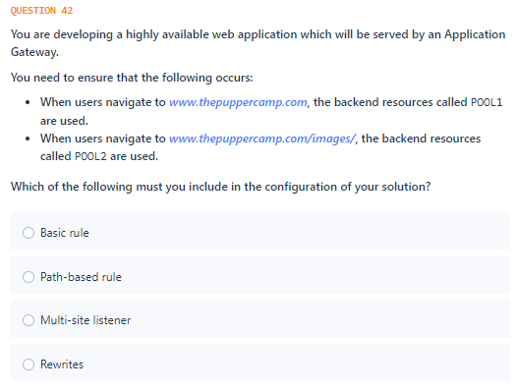

Slide 45
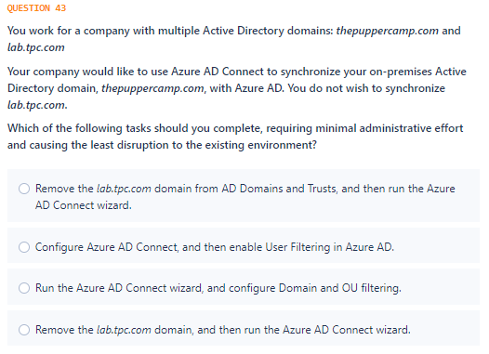

Slide 46
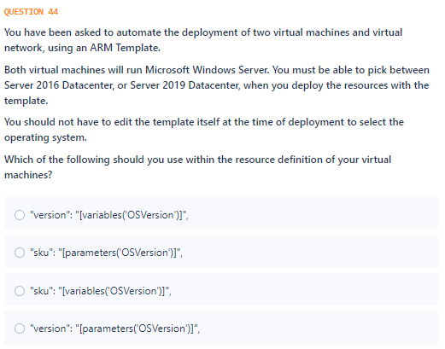

Slide 47
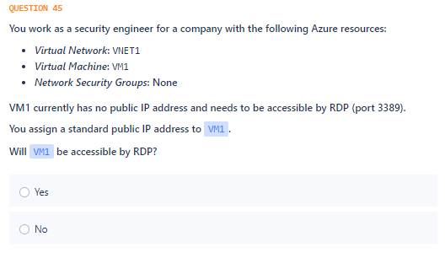

Slide 48
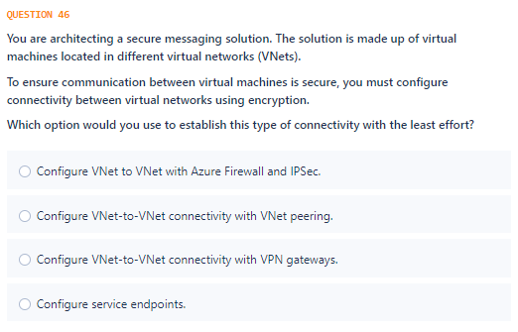

Slide 49
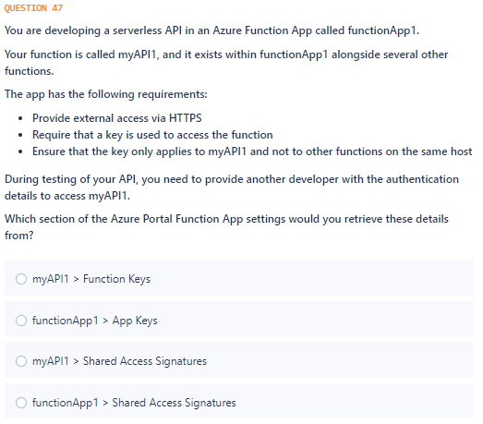

Slide 50
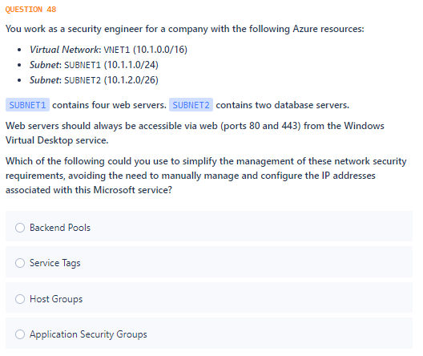

Slide 51


Slide 52


Slide 53


Slide 54


Slide 55


Slide 56


Slide 57


Slide 58


Slide 59


Slide 60


Slide 61


Slide 62


Slide 63
Answers

Slide 64

Notes:
https://docs.microsoft.com/en-us/azure/backup/backup-support-matrix
https://docs.microsoft.com/en-us/azure/backup/backup-architecture

Slide 65


Slide 66

Notes:
https://docs.microsoft.com/en-us/azure/sentinel/connect-data-sources
https://docs.microsoft.com/en-us/azure/sentinel/overview

Slide 67


Slide 68

Notes:
https://docs.microsoft.com/en-us/azure/cosmos-db/how-to-query-container

Slide 69

Notes:
https://docs.microsoft.com/en-us/azure/cosmos-db/unique-keys

Slide 70

Notes:
https://docs.microsoft.com/en-us/sql/dma/dma-overview?view=sqlallproducts-allversions
https://docs.microsoft.com/en-us/azure/dms/dms-overview

Slide 71


Slide 72

Notes:
https://docs.microsoft.com/en-us/azure/governance/blueprints/overview#blueprint-definition

Slide 73

Notes:
https://docs.microsoft.com/en-us/azure/active-directory/develop/howto-create-service-principal-portal

Slide 74

Notes:
https://docs.microsoft.com/en-us/azure/azure-resource-manager/management/azure-subscription-service-limits

Slide 75

Notes:
https://docs.microsoft.com/en-us/azure/storage/common/storage-initiate-account-failover?tabs=azure-portal

Slide 76


Slide 77


Slide 78

Notes:
https://docs.microsoft.com/en-us/azure/container-instances/container-instances-restart-policy
https://docs.microsoft.com/en-us/azure/container-instances/container-instances-environment-variables https://docs.microsoft.com/en-us/azure/container-instances/container-instances-environment-variables#secure-values

Slide 79

Notes:
https://docs.microsoft.com/en-us/azure/app-service/tutorial-custom-container?pivots=container-linux https://docs.docker.com/engine/reference/builder/

Slide 80


Slide 81

Notes:
https://docs.microsoft.com/en-us/azure/cosmos-db/mongodb-introduction

Slide 82


Slide 83


Slide 84

Notes:
https://docs.microsoft.com/en-us/azure/active-directory/hybrid/reference-connect-accounts-permissions

Slide 85

Notes:
https://azure.microsoft.com/en-us/support/legal/sla/virtual-machines

Slide 86


Slide 87


Slide 88


Slide 89

Notes:
https://docs.microsoft.com/en-us/azure/backup/backup-azure-microsoft-azure-backup

Slide 90


Slide 91

Notes:
https://docs.microsoft.com/en-us/azure/governance/policy/samples/enforce-tag-value

Slide 92


Slide 93


Slide 94

Notes:
https://docs.microsoft.com/en-us/azure/virtual-network/public-ip-addresses#basic

Slide 95

Notes:
https://docs.microsoft.com/en-us/azure/role-based-access-control/overview

Slide 96

Notes:
https://docs.microsoft.com/en-us/azure/app-service/overview-managed-identity?tabs=dotnet

Slide 97

Notes:
https://docs.microsoft.com/en-us/azure/cosmos-db/mongodb-introduction

Slide 98

Notes:
https://docs.microsoft.com/en-us/azure/sql-database/sql-database-auto-failover-group

Slide 99
Notes:
https://docs.microsoft.com/en-us/azure/active-directory/authentication/concept-sspr-writeback

Slide 100


Slide 101

Notes:
https://docs.microsoft.com/en-us/cli/azure/webapp?view=azure-cli-latest#az_webapp_up

Slide 102

Notes:
https://docs.microsoft.com/en-us/azure/migrate/migrate-support-matrix#supported-tools

Slide 103


Slide 104

Notes:
https://docs.microsoft.com/en-us/azure/private-link/private-link-overview

Slide 105

Notes:
https://docs.microsoft.com/en-us/azure/application-gateway/create-url-route-portal

Slide 106

Notes:
https://docs.microsoft.com/en-us/azure/active-directory/hybrid/how-to-connect-sync-configure-filtering

Slide 107

Notes:
https://docs.microsoft.com/en-us/azure/templates/microsoft.compute/2020-06-01/virtualmachines#imagereference-object

Slide 108

Notes:
https://docs.microsoft.com/en-us/azure/virtual-network/public-ip-addresses#standard

Slide 109


Slide 110

Notes:
https://docs.microsoft.com/en-us/azure/azure-functions/security-concepts#authorization-scopes-function-level

Slide 111

Notes:
https://docs.microsoft.com/en-us/azure/virtual-network/service-tags-overview

Slide 112

Notes:
https://docs.microsoft.com/en-us/azure/active-directory/governance/access-reviews-overview

Slide 113

Notes:
https://docs.microsoft.com/en-us/azure/active-directory/authentication/concept-sspr-howitworks#authentication-methods

Slide 114

Notes:
https://docs.microsoft.com/en-us/azure/role-based-access-control/overview
https://docs.microsoft.com/en-us/azure/role-based-access-control/built-in-roles#owner

Slide 115


Slide 116

Notes:
https://docs.microsoft.com/en-us/azure/backup/backup-create-rs-vault#set-storage-redundancy

Slide 117

Notes:
https://docs.microsoft.com/en-us/azure/active-directory/managed-identities-azure-resources/how-managed-identities-work-vm

Slide 118

Notes:
https://docs.microsoft.com/en-us/azure/virtual-network/application-security-groups

Slide 119

Notes:
https://docs.microsoft.com/en-us/azure/active-directory/hybrid/how-to-connect-health-adfs

Slide 120


Slide 121


Slide 122

Notes:
https://docs.microsoft.com/en-us/azure/virtual-network/virtual-network-network-interface#change-dns-servers

Slide 123

Notes:
https://docs.microsoft.com/en-us/azure/bastion/tutorial-create-host-portal

Slide 124
Thank you!

